Slide 1
WATER VENDING MACHINE MANAGEMENT SYSTEM
DESIGN DOCUMENT

Slide 2
Features of the project:
User: owner:
Register issue smart card
Login issue water based on coins
Take water using smart card issue water based on smart card
Take water using coins Check balance
Unregister Recharge smart card
check balance
database:
update water records

Slide 3


REGISTER
ISSUE SMART CARD TO THE REGISTERED USER
LOGIN
ISSEUE WATER WITH SMART CARD
TAKE WATER USING SMART CARD
CHECK BALANCE
CHECK BALANCE
DATABASE
OWNER
USER
RECHARGE SMART CARD
UNREGISTER
ISSUE WATER WITH COINS
TAKE WATER USING COINS
An unregistered user can take water using coins.

Slide 4
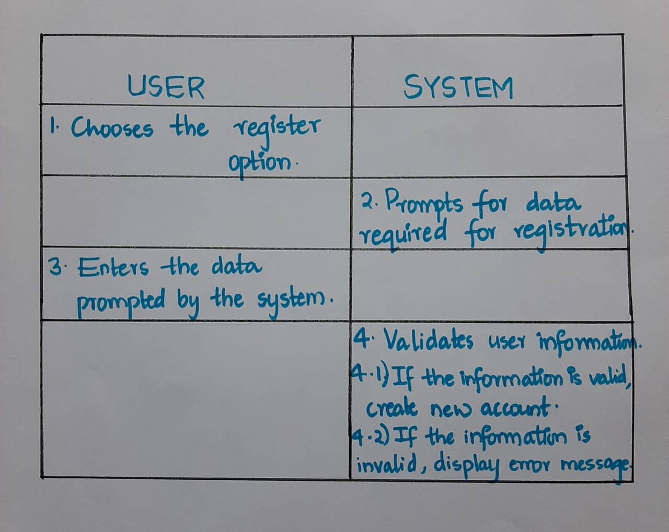
Use case ID: UC01 Name: Register Actors: User Description : Allows new user to register for an account Pre-conditions: None Post-conditions: An account is created for the user and a smart card is issued by owner with zero balance Main flow:

Slide 5
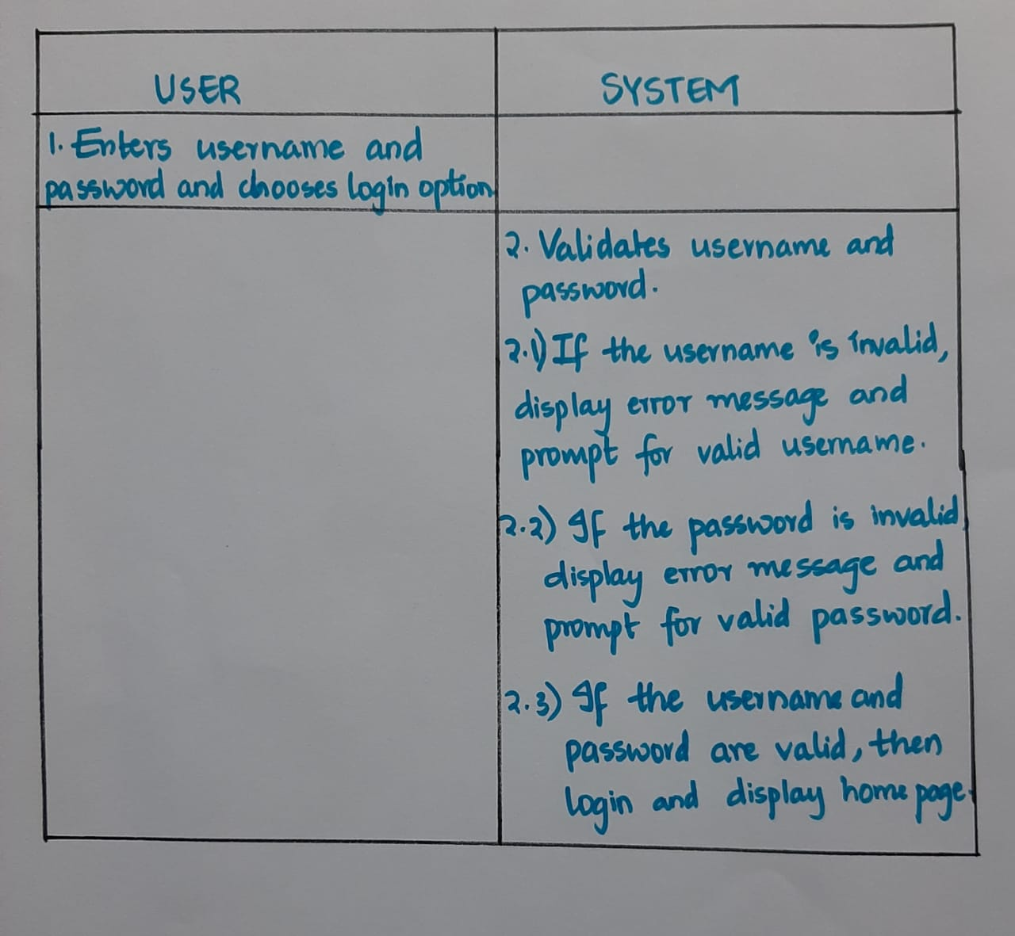
Use Case ID: UC02 Name: Login Actors: User Description: Allows registered users to Login Pre-conditions: user should be registered with the system Post-conditions: User logs in and all the options are displayed on the screen Main Flow:

Slide 6
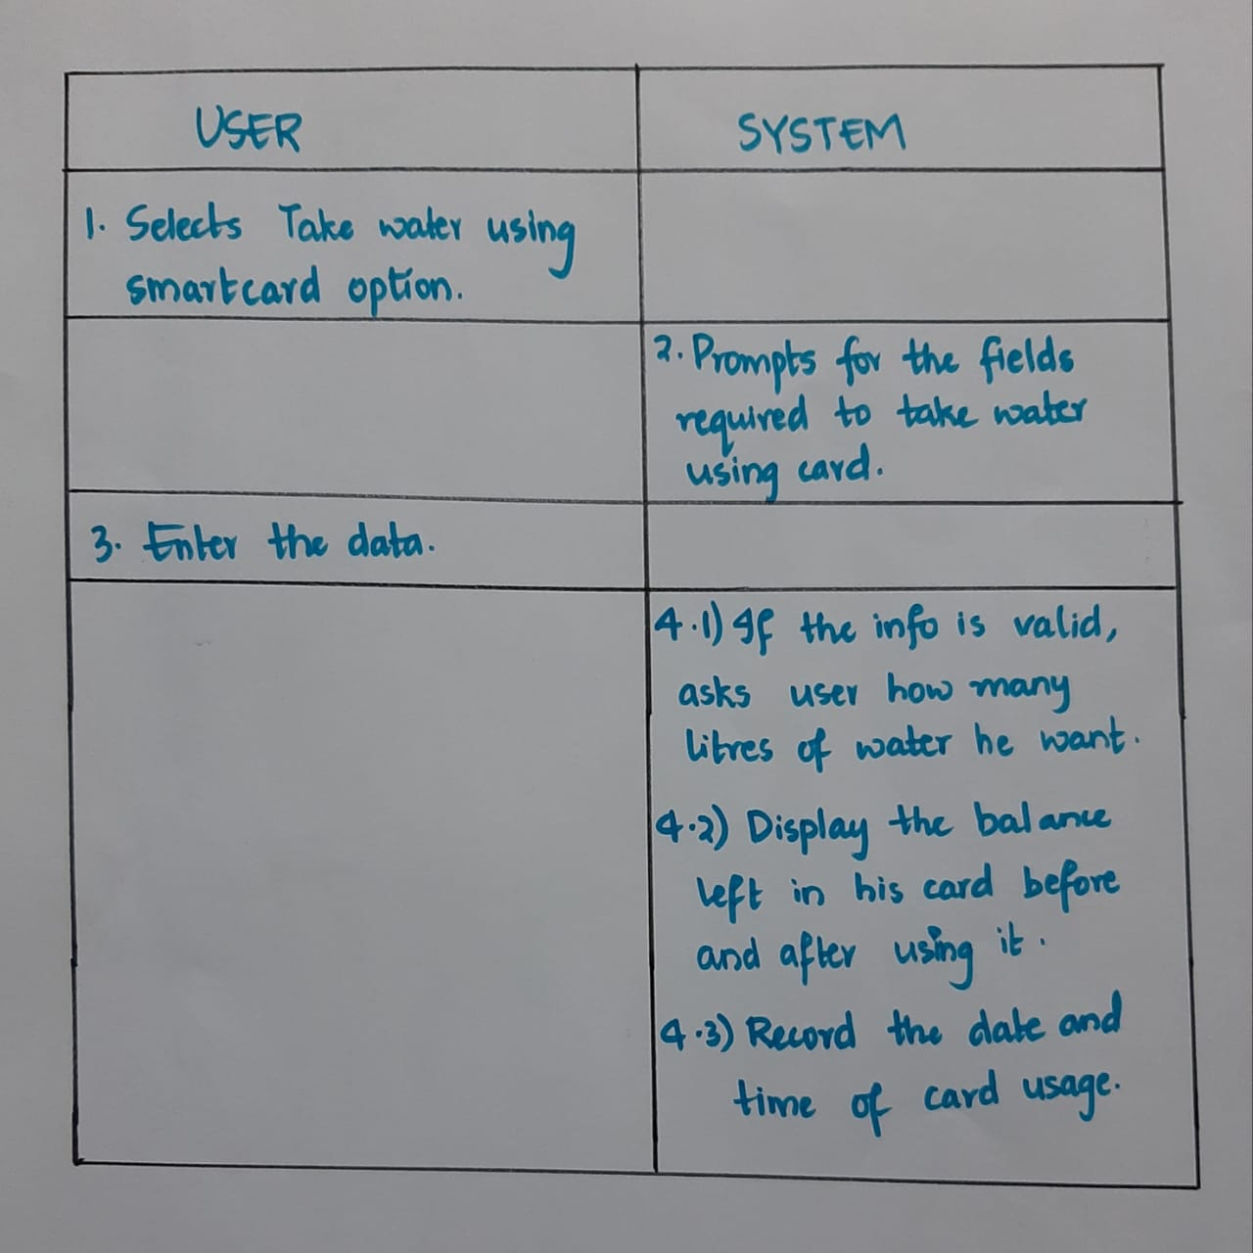
Use Case ID: UC03 Name: Take water using his card Actors: User Description: Allows registered users to take water using card Pre-conditions: User should be successfully signed-in to the system Post-conditions: Owner allows user to take water Main flow:

Slide 7
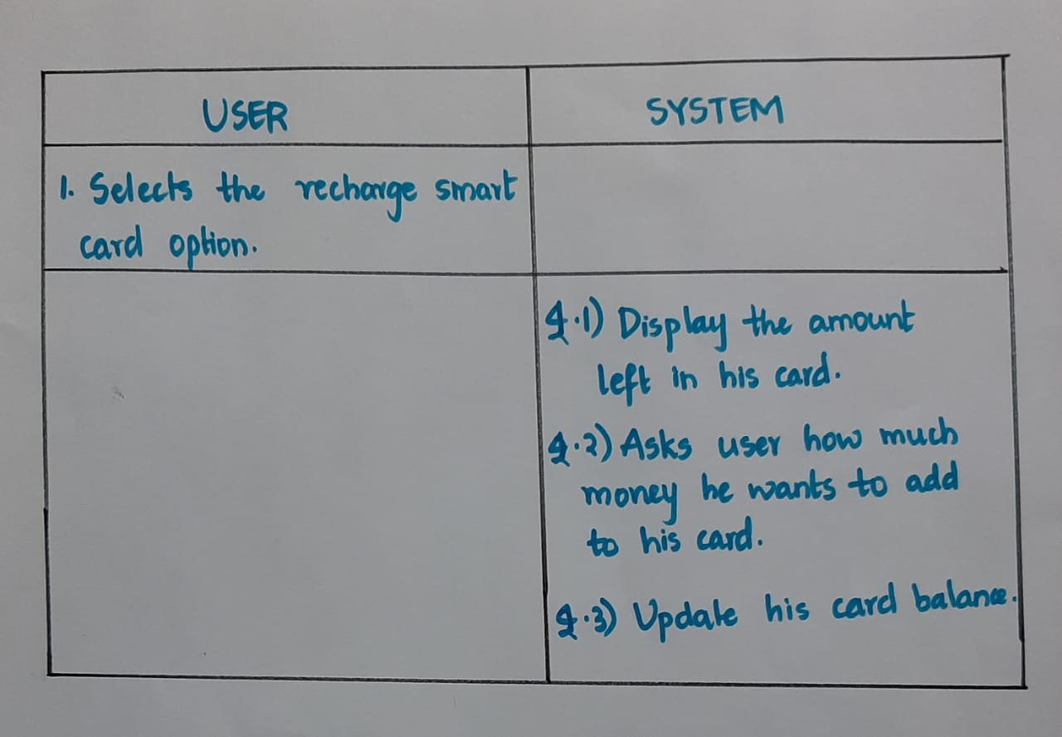
Use Case ID: UC04 Name: Recharge his card Actors: Owner Description: Recharges user’s smart card Pre-conditions: User should be successfully signed-in to the system Post-conditions: User’s smart card is recharged Main flow:

Slide 8
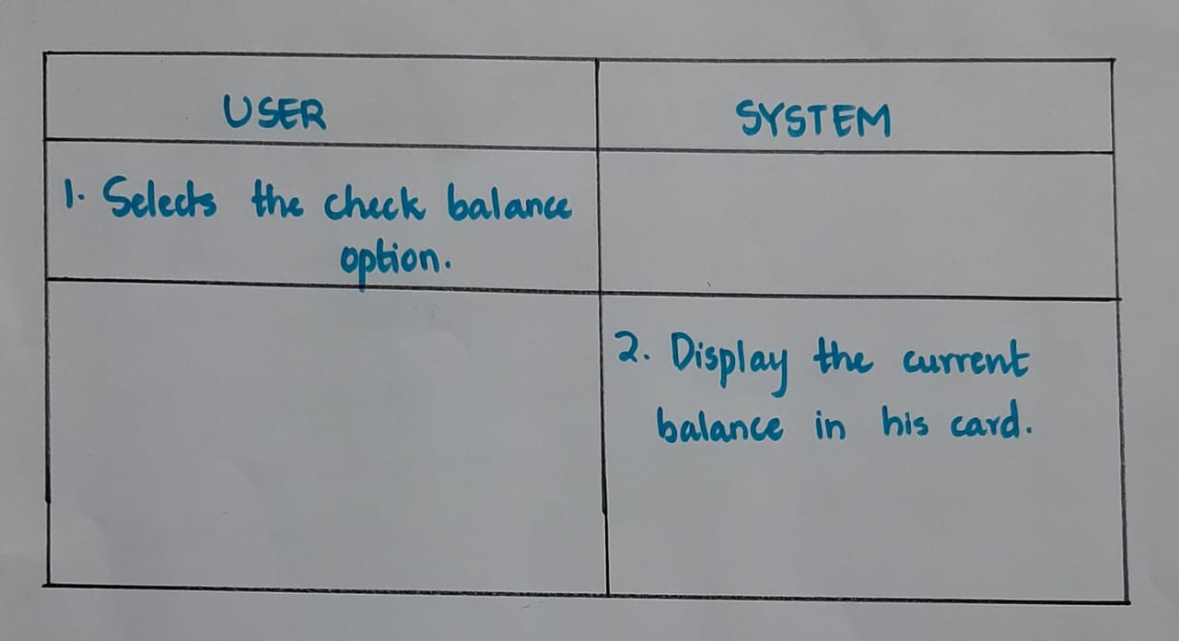
Use Case ID: UC05 Name: Check balance Actors: user Description: Displaying balance amount in user’s card Pre-conditions: User should be successfully signed-in to the system Post-conditions: none Main flow:

Slide 9
Use Case ID: UC06 Name: Take water using coins Actors: user and owner Description: The user will take water from the owner by giving coins Pre-conditions: User should mention the quantity of water required and give the coins needed to take that amount of water. Post-conditions: Details of the unregistered users will be stored in a separate file
USER | OWNER
specify the number of litres he requires and give coins to the user. | Give the specified quantity of water to the user after taking coins.

